Slide 1
Polymers
- ABDURRAHMAN QURESHI 210451

Slide 2
Chemistry micro-project students report
TITLE : Type Of Polymers And Their Application.
NAME : ABDURRAHMAN QURESHI
ROLL NO. : 210451
BRANCH : COMPUTER ENGINEERING
SEM : 1st

Slide 3
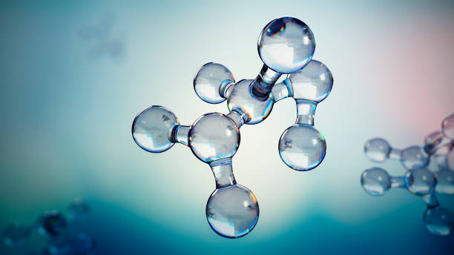
Monomers
A monomer is a molecule that can react together with other monomer molecules to form a larger polymer chain or three-dimensional network in a process called polymerization.
Polymers
Polymers are large molecules made up of long chains or networks of smaller molecules called monomers. Polymers make up many of the materials in living organisms and are the basis of many minerals and man-made materials.

Slide 4
Types of Polymers
Polystyrene
Polyvinyl Chloride
Polyethylene
Nylon
Teflon

Slide 5
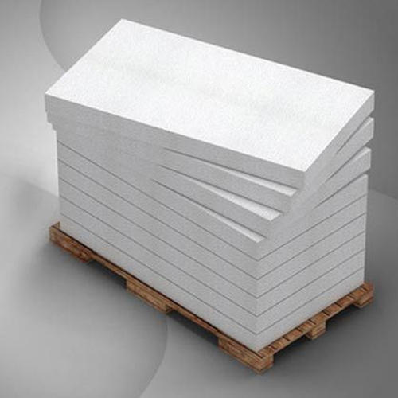
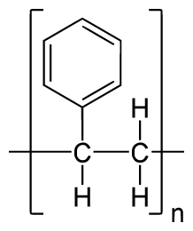
Polystyrene
Polystyrene is a synthetic aromatic hydrocarbon polymer made from the monomer known as styrene. Polystyrene can be solid or foamed. General-purpose polystyrene is clear, hard, and brittle. It is an inexpensive resin per unit weight.
Chemical Formula : (C₈H₈)_{n}
Uses : rigid trays, containers, disposable eating utensils, foamed cups, plates, and bowls

Slide 6
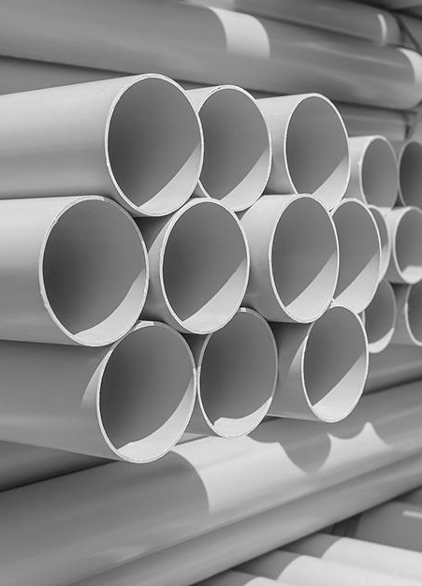
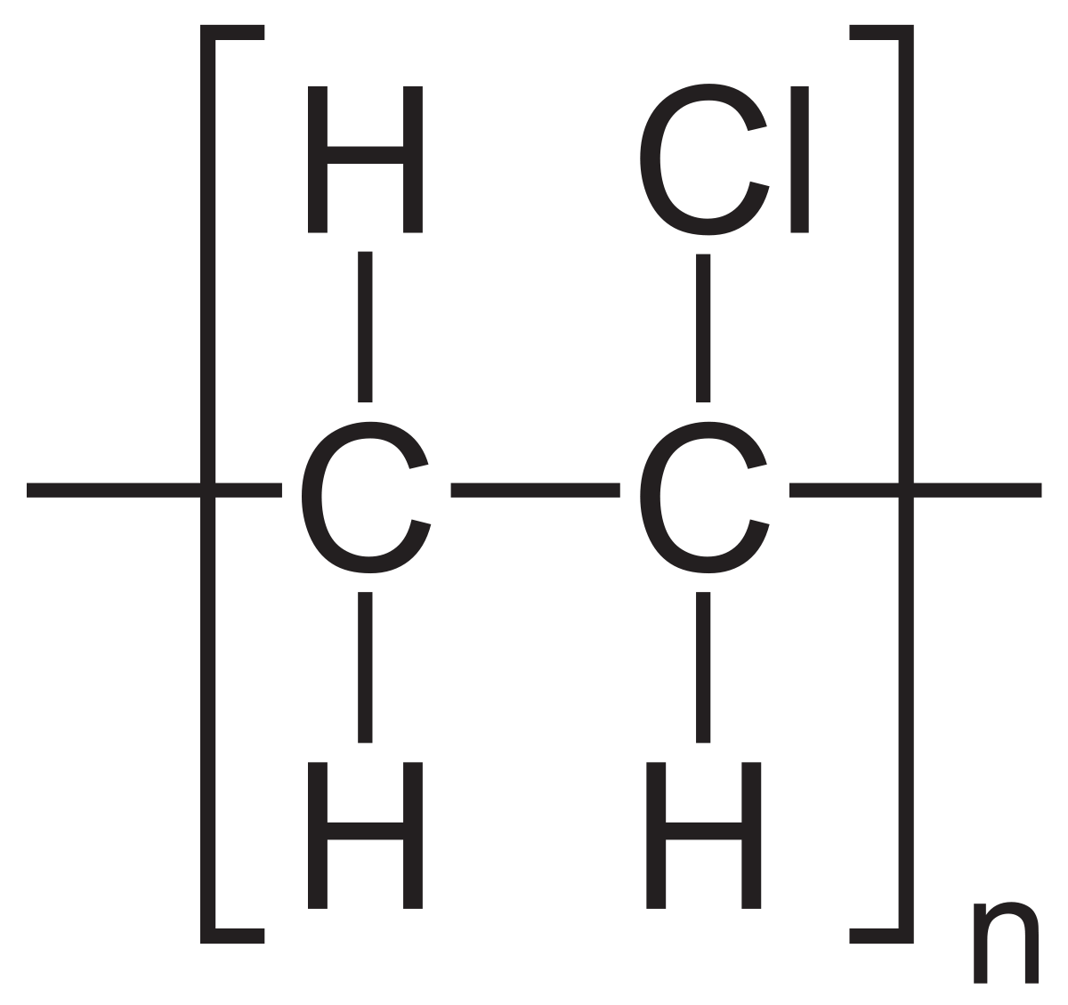
Polyvinyl Chloride
Polyvinyl chloride or vinyl (PVC) is a polymer in which more than half of the content by weight consists of chlorine. PVC is produced by polymerization of the vinyl chloride monomer. PVC comes in two basic forms: Rigid and flexible
Chemical Formula : (C₂H₃Cl)_{n}
Uses : Window Frames, Drainage Pipe, Water Service Pipe, Medical Devices, Blood Storage Bags, Cable And Wire Insulation, Etc.

Slide 7
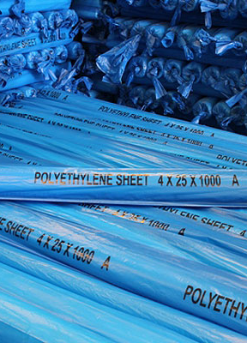
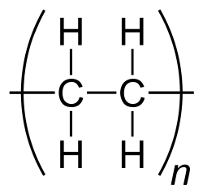
Polythene
Polyethylene or polythene is light, versatile synthetic resin made from the polymerization of ethylene. And it’s the most common plastic in use today. It is a polymer, primarily used for packaging.
Chemical Formula : (C₂H₄)_{N}
Uses : Packaging Film, Garbage Bags, Grocery Bags, Insulation For Wires And Cables, Agricultural Mulch, Bottles, Toys, And Houseware.

Slide 8
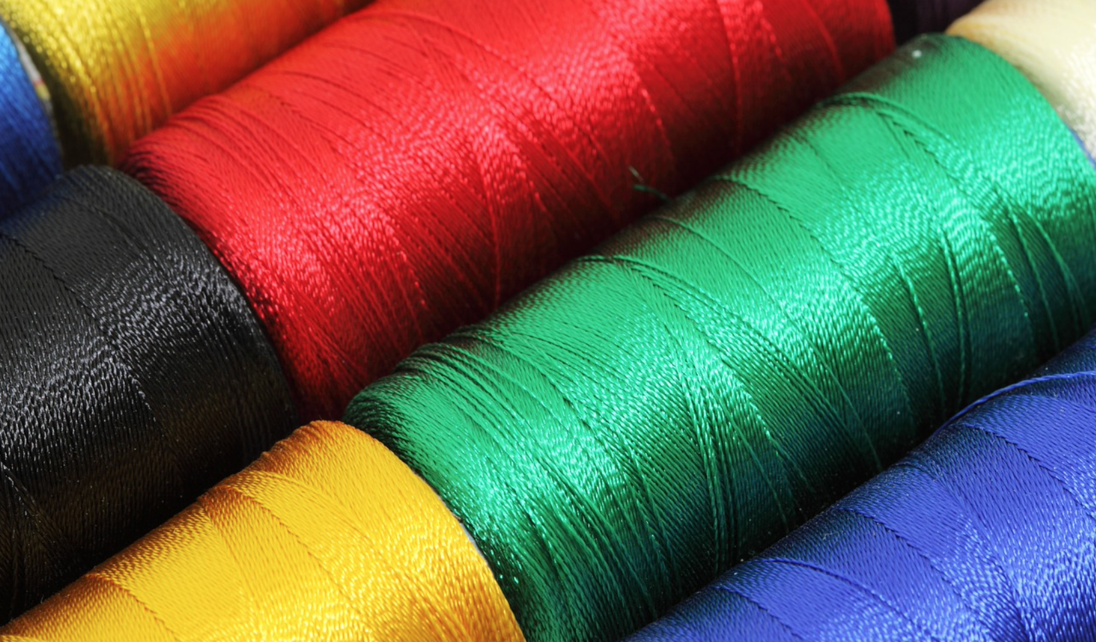
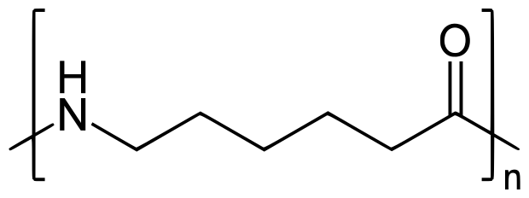
Nylon
Nylon is a generic designation for a family of synthetic polymers composed of polyamides. Nylon is a silk-like thermoplastic, generally made from petroleum, that can be melt-processed into fibers, films, or shapes.
Chemical Formula : (C₁₂H₂₂N₂O₂)_{n}
Uses : Clothing (Shirts, raincoats, swimwear and cycle wear); Industrial Uses (Seat belts, parachutes, airbags, nets and ropes); Fishnet.

Slide 9
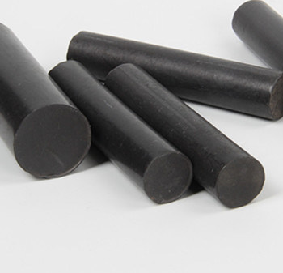
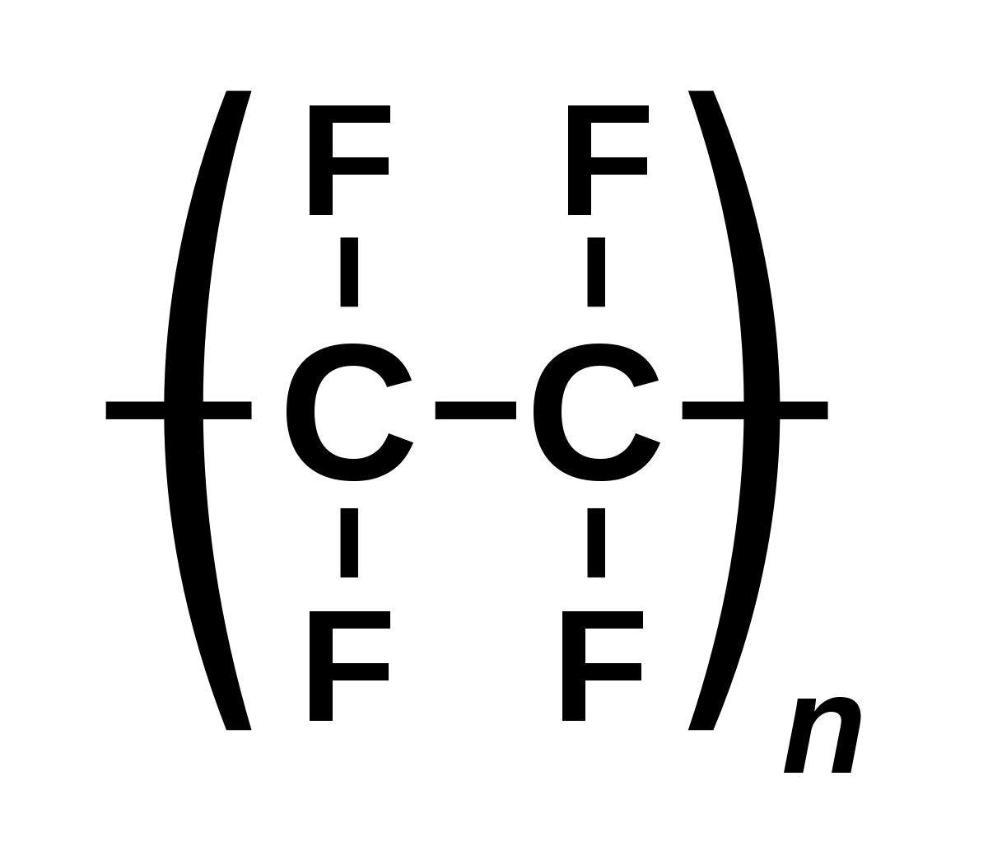
Teflon
Teflon is not a product on its own, but a brand name of a product. It refers to a chemical coating known as polytetrafluoroethylene (PTFE). It's a type of plastic sprayed on various items and then baked to create a nonstick, waterproof, noncorrosive, and nonreactive surface
Chemical Formula : (C₂F₄)_{n}
Uses : Waterproof Fabric, Non-stick Cookware, An Anti-friction Device, Coating Medical Appliances (Surgical Devices).

Slide 10
Conclusion
In conclusion, we can say that Polymers are very big molecules made up of many smaller molecules layered together in a repeating pattern, these different types of polymers are very useful in our day-to-day lives and Both natural and synthetic polymers are remarkably involved in comfort and facilitation of human life and are responsible for life itself, for medication, nutrition, communication, transportation, irrigation, container, clothing, recording history, buildings, highways, etc. Both natural and synthetic polymers play a huge role in everyday life, and a life without polymers might not exist. Cells build our bodies, and cells are built of polymers. Plants are built of cellulose, which is a polymer. If polymers would suddenly disappear, life would disappear with it.

